Slide 1
Fair and Equitable Assessment:
Strategies For Working With English Learners
Dr. Pedro Olvera
polvera@calbaptist.edu
Cal Baptist University
Associate Faculty
08/11/2022
Riverside Evalu8

Slide 2
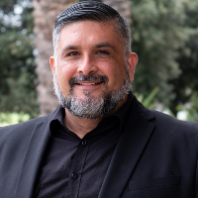
About Me
Bilingual School Psychologist for -21 years (Southern California)
Associate Professor/Program Director-14 years (Cal Baptist University)
Private Practice–14 years
My philosophy of practice is informed by clinical practice and personal experience as a former EL, child of immigrants, growing up along the southwest border, and growing up in a very diverse part of San Diego.

Slide 3
Objectives
Identify assessment practices that are biased and discriminatory towards English learners.
Describe assessment practices that are fair and equitable for working with English learners.
Identify strategies to engage in fair and equitable practices in clinical practice.

Slide 4
Biased and Discriminatory Assessment Practices Towards English Learners (ELs):
Check our Biases
Disproportionality in Special Education (SPED)

Slide 5
“We found that EL classification resulted in teachers having lower academic expectations of their students. The effects were modest in size in kindergarten, but grew as students moved to first and second grades (reaching about a quarter of the standard deviation).”

Slide 6
“Studies have found that at all levels of education, instructors often favor students who sound like themselves and can be biased against those who don’t. Educators might form negative assumptions about a student’s intelligence and ability based simply on how he or she talks, which can result in lowered expectations, stereotyping and discrimination. Teachers sometimes also send messages, whether consciously or unconsciously, that a student’s language is wrong, dumb or out of place at school.”

Slide 7
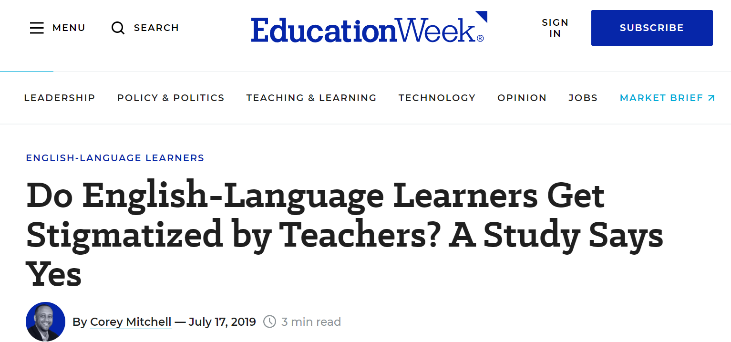
“Their findings indicate that, across all the grade levels and content areas, teachers had lower perceptions of the academic skills and knowledge of those students who were classified as English-learners.”

Slide 8
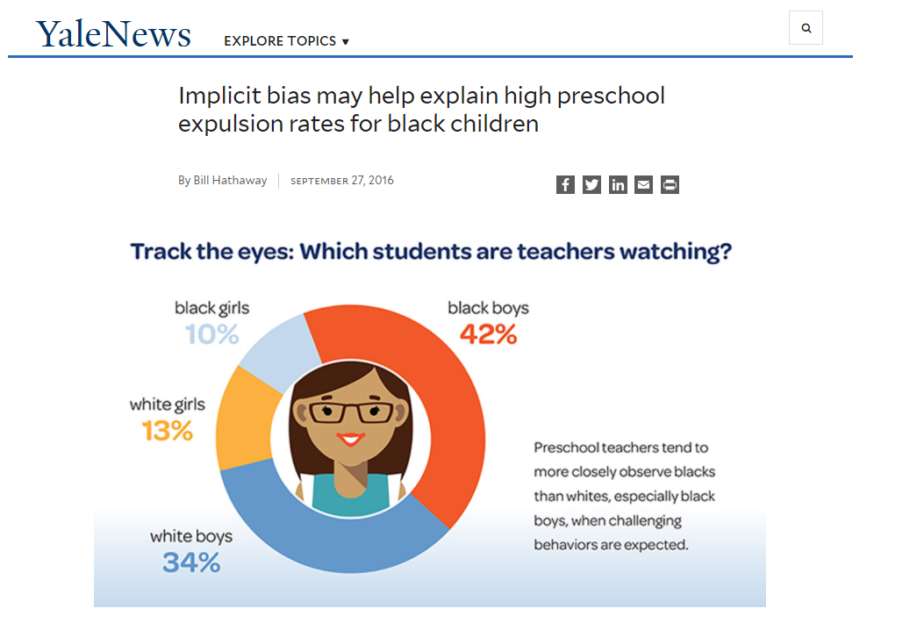

Slide 9
Descriptive statistics and regression analyses examined patterns and predictors of identification and placement in special education among English learners throughout the state relative to their White peers. The results indicate that these students are increasingly likely to be identified as having learning disabilities or mental retardation, and are less likely to be served in either the least or most restrictive educational environments relative to their White peers.

Slide 10
“Teacher attitudes toward inclusion of English Learners (ELs) in the mainstream classroom have primarily focused on explicit beliefs as accessed through observation, case studies, and self-report surveys. The authors explore implicit mainstream teacher beliefs about ELs using the newly created Implicit Association Test–EL, with correlations to explicit beliefs being made using the English-as-a-Second-Language (ESL) Students in Mainstream Classrooms: A Survey of Teachers’ Explicit Beliefs survey. Findings from the IAT–EL indicate a slightly negative implicit belief about ELs from 197 respondents.”

Slide 11
Questions/Points to Consider
Do we inadvertently assume low intelligence and/or a disability because of our implicit bias towards ELs?
Do we see SPED as a means to “help”?

Slide 12
2. Fair and equitable assessment practices for working with English learners:
Understand that ELs= Bilinguals
Understanding Language 2nd Development
Validation of Assessment Outcomes

Slide 13
“Some of the bilingual's vocabulary tends to be available in one language without translation equivalent vocabulary being available in the other language. Thus it can be said that lexicalized concepts of the bilingual are 'distributed' across the two languages such that some concepts are lexicalized in one language but not the other and vice versa.”

Slide 14
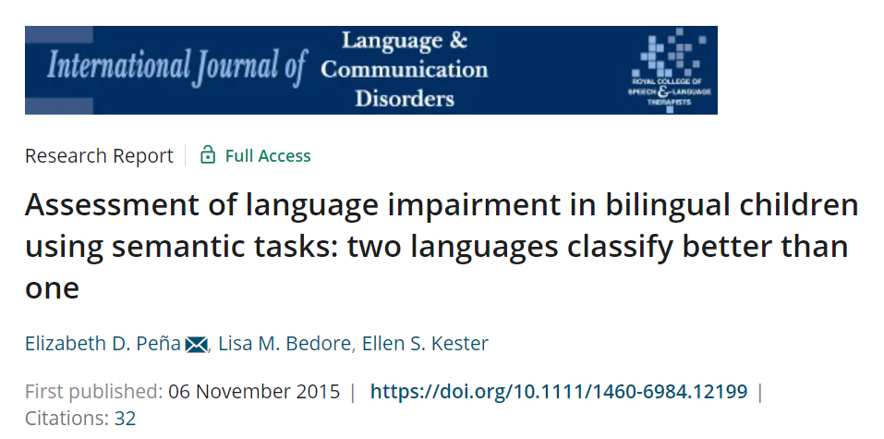
Conclusions & Implications: “For the most accurate assessment and diagnostic decision-making for bilinguals, approaches that consider both languages together are recommended.”

Slide 15
Proficiency in one language
(English-only)

Slide 16
Proficiency in two languages
L1 L2

Slide 17
Uneven proficiency in two languages
(Future Bilingual)
L1 L2

Slide 18
Minimal proficiency in both languages
Pejorative: Semilinguals/Alinguals
L1 L2

Slide 19
When we test ELs in only one language or expect them to function in a classroom where full proficiency in English is required.
L1 L2

Slide 20
Questions/Points to Consider
How will your perceptions of ELs change when considering them bilinguals?
How will your assessment practices change knowing bilingual children have language distributed in their L1 and L2?

Slide 21
3. Identify strategies to engage in fair and equitable practices in clinical practice:
Commitment to Data Validation
Personal and Systemic Strategies

Slide 22
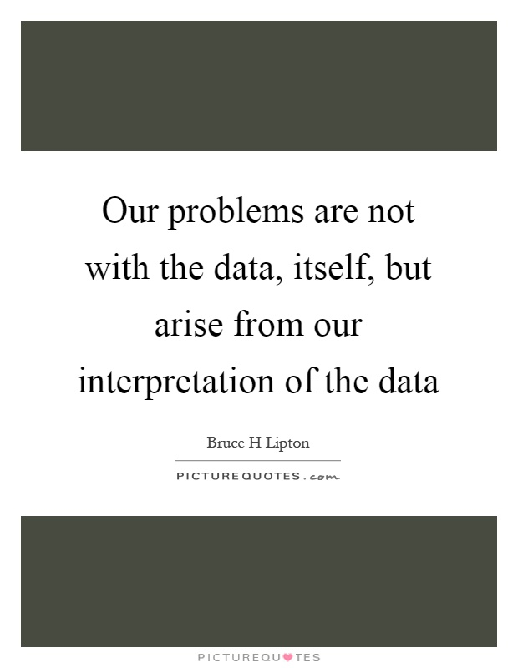

Slide 23
Standard Scores of the Tip of the Iceberg

Slide 24
Data Validation- The process of ensuring
the accuracy and quality of the data for
educational decision-making.

Slide 25
Key Factors to Consider in Validating Assessment Data
Thorough Investigation of Context and Background Information
Analysis of Language of Instruction and Academic Supports
Analysis of Evidenced-based Interventions (linguistically-appropriate)
Assessment of Progress Relative to Similar Peers
Assessment of Language Proficiency and Dominance
Selection of culturally and linguistically appropriate tools and procedures that will help you answer the referral question
Consideration of Acculturation Factors (Cultural Validity)
Incorporation of Accommodations (test-publishers)
Notes:
8 key areas that we should consider when validating data. We will be examining some of the key steps.

Slide 26
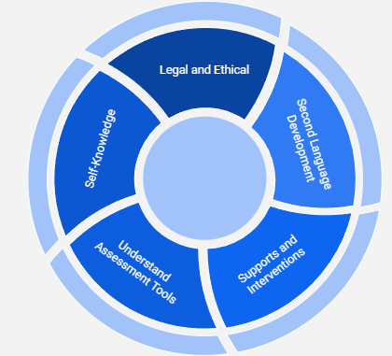
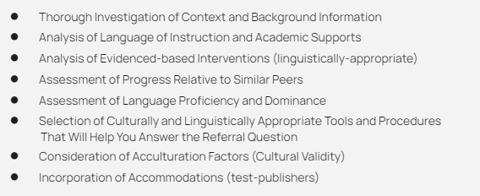
Context Knowledge
(Ongoing Commitment to
Professional Development)
Data Validation
( Commitment to the Process)

Slide 27
Personal
Commitment to cultural competence and humility.
Reflection on personal biases (preconceived notions) and their impact on data interpretation.
Commitment to staying current with research, best assessment practices, and continual self-reflection.
Connecting with peers that are committed to equitable assessment practices.
Systemic
Advocate for evidence-based interventions validated for ELs (MTSS).
Advocate for the hiring of bilingual/bicultural school psychologists and interpreters.
Advocate for culturally and linguistically appropriate tools and practices.
Awareness of EL identification rates in your schools/districts
Enhance home-school partnerships through respectful relationships.

Slide 28
Fair and Equitable Assessment:
Strategies For Working With English Learners
Dr. Pedro Olvera
polvera@calbaptist.edu
Cal Baptist University
Associate Faculty

